Slide 1
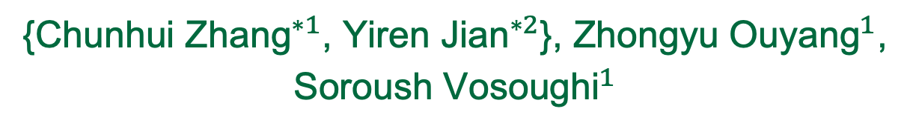

Pretrained Image-Text Models are Secretly Video Captioners
{${\text{Chunhui} \text{Zhang}}^{∗1}$, ${\text{Yiren} \text{Jian}}^{∗2}$}, ${\text{Zhongyu} \text{Ouyang}}^{1}$, ${\text{Soroush} \text{Vosoughi}}^{1}$
${}^{1}$Dartmouth College, ${}^{2}$OpenAI (currently)
Reinforcement learning helped us achieve
a Top-2 ranking on the PaperWithCode leaderboard.

Slide 2
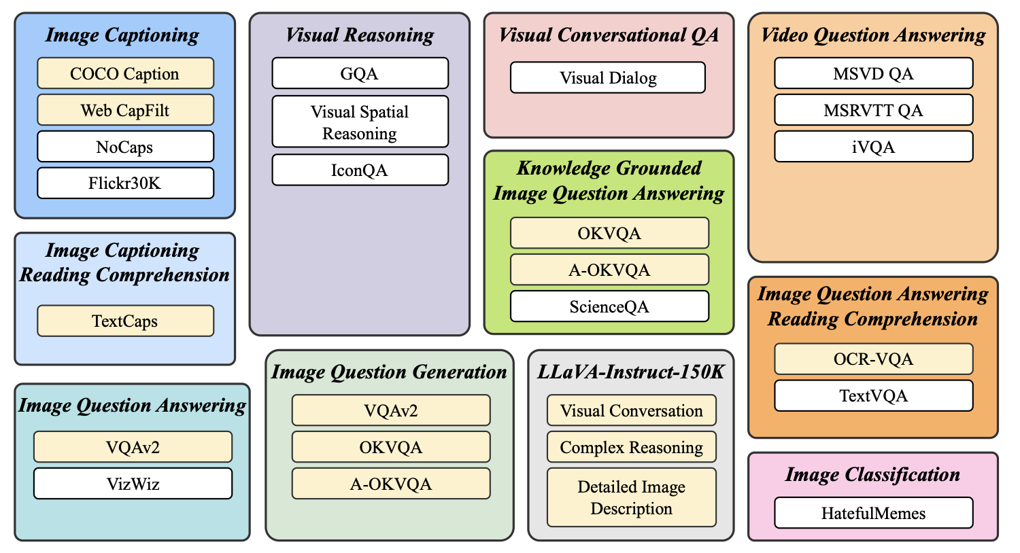
Recap
Instruction tuning allowed the MLLMs to follow human instructions and improve performance on zero-shot tasks
Figure copied from InstructBLIP paper

Slide 3
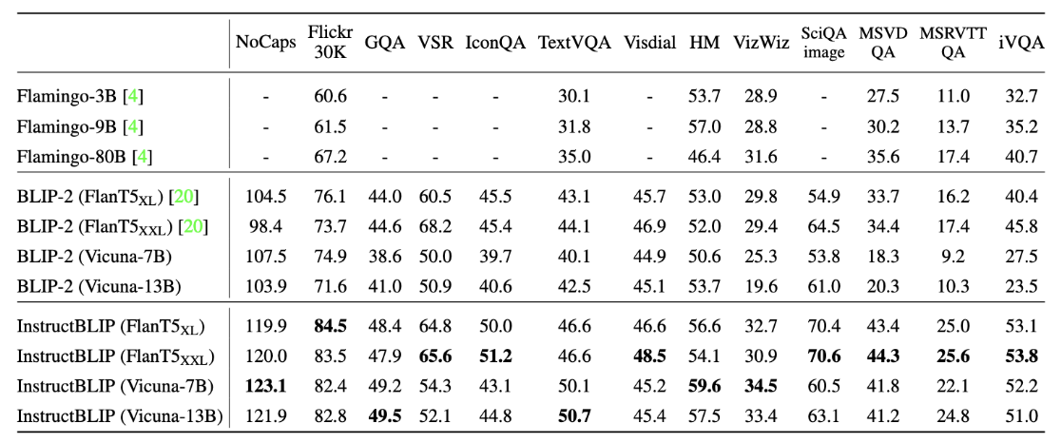
Challenges
InstructBLIP excels at zero shot learning in image QA datasets but MSRVTT Video QA datasets.

Slide 4
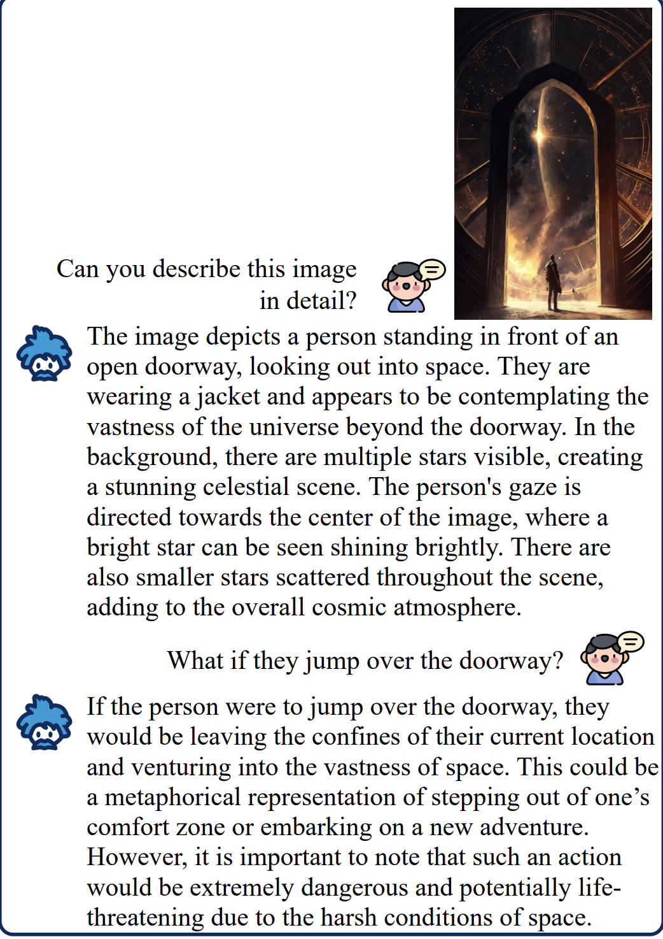
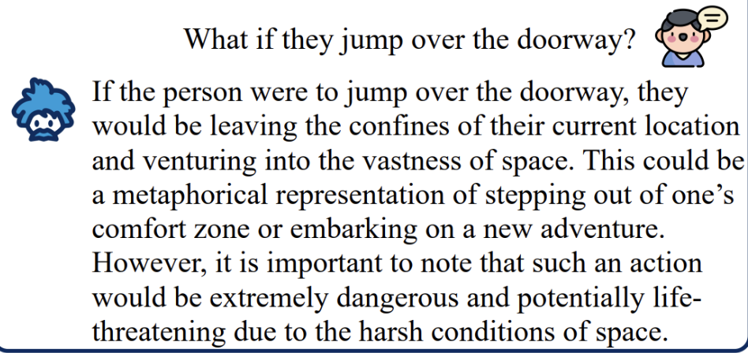
Motivation: Hypothesis
InstructBLIP may be using shortcuts to answer questions based on correlations between questions and visual input
Video captioning requires direct understanding
InstructBLIP might be ignoring the temporal visual dynamics in video caption tasks
Less focus on visual input
“Person might be caught in mid air on a sky”

Slide 5
Question
Under resource constraints (model, data, supervision), how can image captioning models be efficiently repurposed for video captioning?

Slide 6
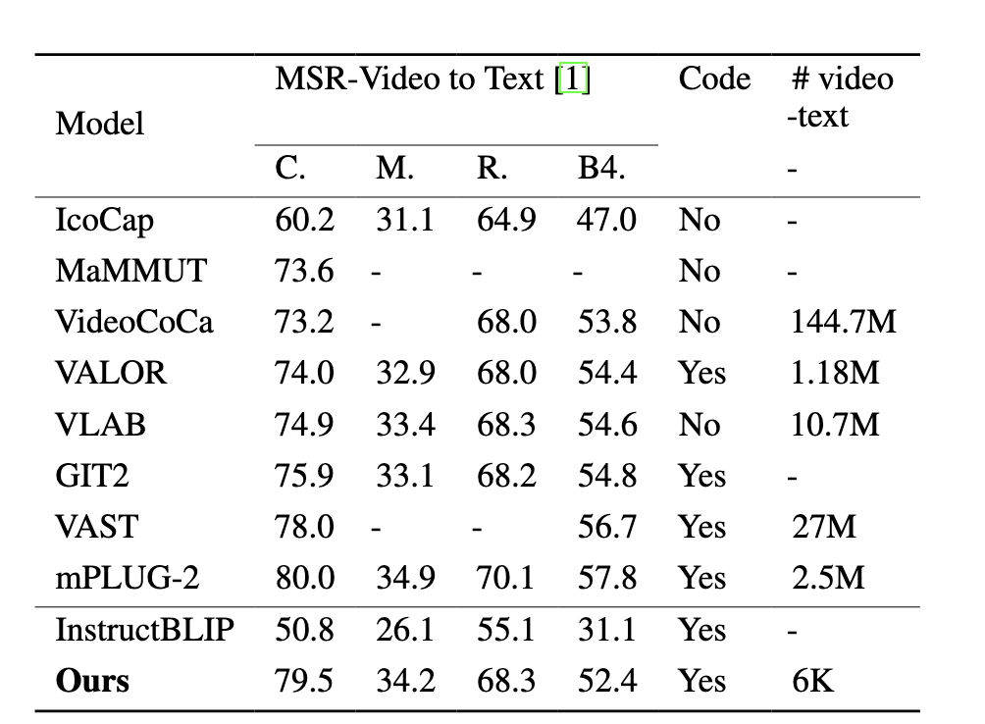
Hypothesis Test on Video
We first evaluated InstructBLIP on MSR-VTT-Caption using zero shot tasks for video captioning

Slide 7
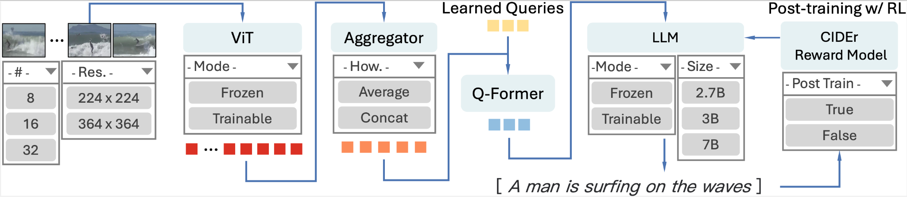
RL Post-training Pipeline
We use CIDEr score as metric-based reward to supervise video captioning.
Notes:
in supervised learning, output the caption, it only tried to predict the same caption text. For reinforcement learning supervision, the model tried to learn the output the text that have better CIDER score.
For supervised learning, they only use cross entropy
Finetune the Q-Former LLM
Q-Fromer is the most triable one/ doesn’t impact the final result significantly,
train all components
freeze ViT only, train Q former only
RL with Cider metrics, so that it can generate sequence with human-like sequence

Slide 8
Model Architecture
ViT, Q-Former as the modal connector, Flan-T5-XL as the language module
Video inputs: 16 frames/video, 224x224 resolution.
Query embeddings were concatenated before being fed into the language module
Notes:
in supervised learning, output the caption, it only tried to predict the same caption text. For reinforcement learning supervision, the model tried to learn the output the text that have better CIDER score.
For supervised learning, they only use cross entropy
Finetune the Q-Former LLM
Q-Fromer is the most triable one/ doesn’t impact the final result significantly,
train all components
freeze ViT only, train Q former only
RL with Cider metrics, so that it can generate sequence with human-like sequence

Slide 9
Optimal Configuration Summary
Fine-tune InstructBLIP model on MSR-VTT-Caption dataset,
while 1)freezing ViT 2)Q-Former Only 3) Post-Training with Reinforcement Learning
Notes:
Uses Cider reward model -> so that it focuses more on captions that are more semantically close even if it deviates from ground truth
the model would automatically know how to achieve captions that resemble the ones humans created it
let the model to directly optimize the CIDER score/ which measures whether the language resembles the ones humans created it
cross entropy is differentiable
but the metric is not differentiable so we use the reinforcement learning
parameters are the ones we control and we test on which combination works the best

Slide 10
Data Setup
Dataset Preparation
Utilized MSR-VTT-Caption dataset
10,000 video clips across 20 categories
Split data
6,513 clips for training
497 clips for validation
2,990 clips for testing

Slide 11
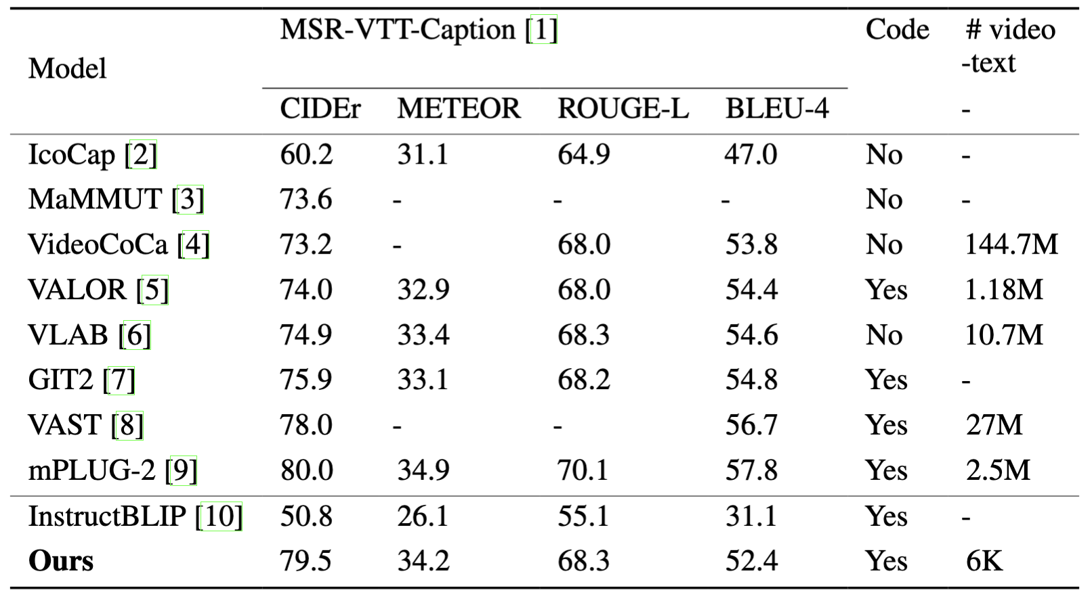
We achieved 2nd best against SoTA video captioners

Slide 12
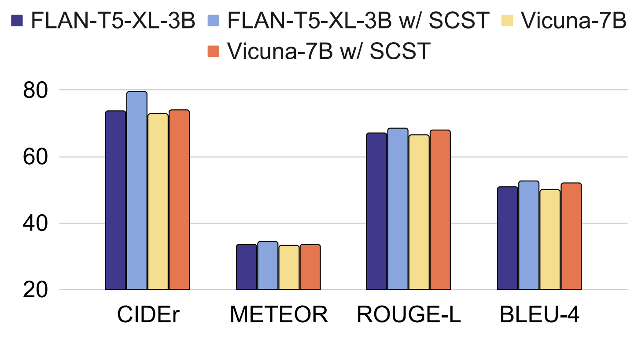
Key Findings
Reinforcement Supervision:
Reinforcement learning (SCST) aligns captions with human preferences
Improved CIDEr scores by 3.4-6.5%

Slide 13
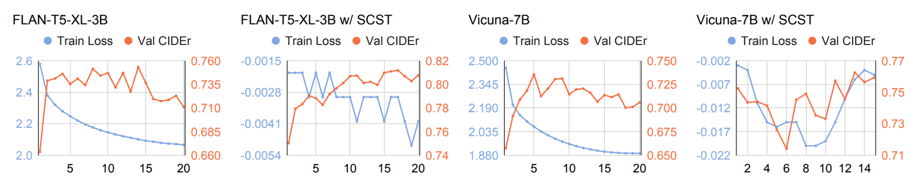
Key Findings
Reinforcement Supervision:
Reinforcement learning (SCST) aligns captions with human preferences
Improved CIDEr scores by 3.4-6.5%

Slide 14
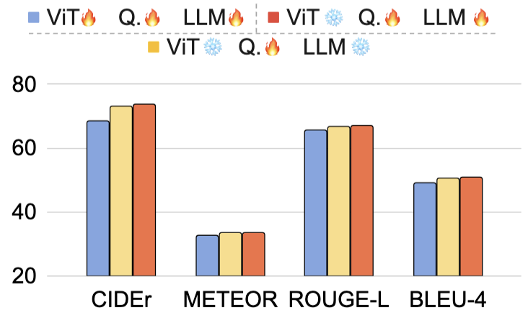
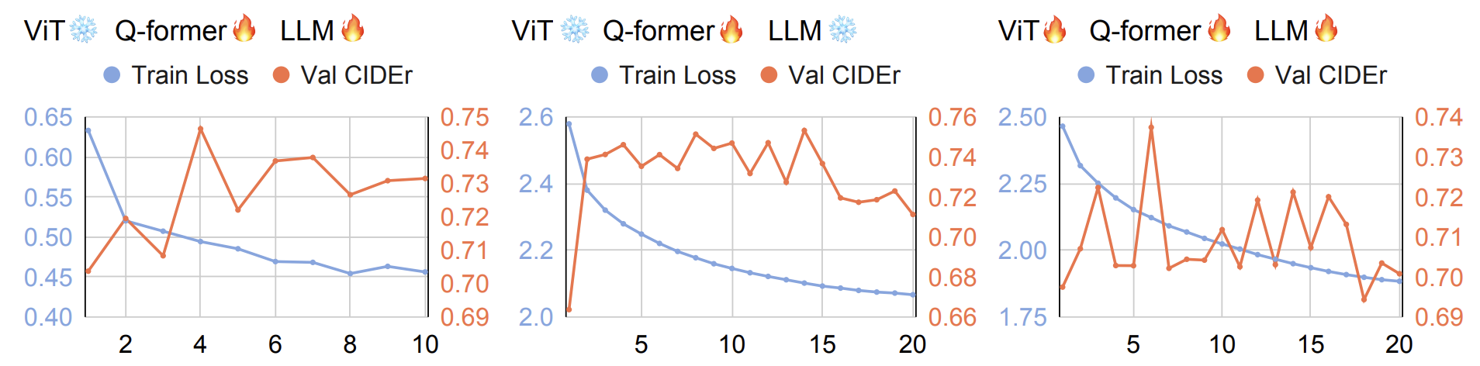
Key Findings
Model Scale:
Trainability hierarchy: Q-Former > LLM > ViT

Slide 15
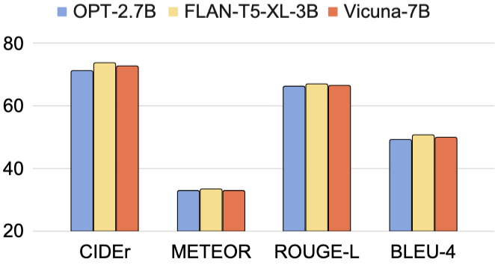
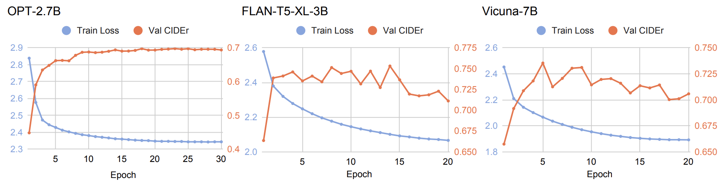
Key Findings
Model Scale:
Mid-sized LLMs (e.g. Flan-T5-XL-3B) work best for video captioning

Slide 16
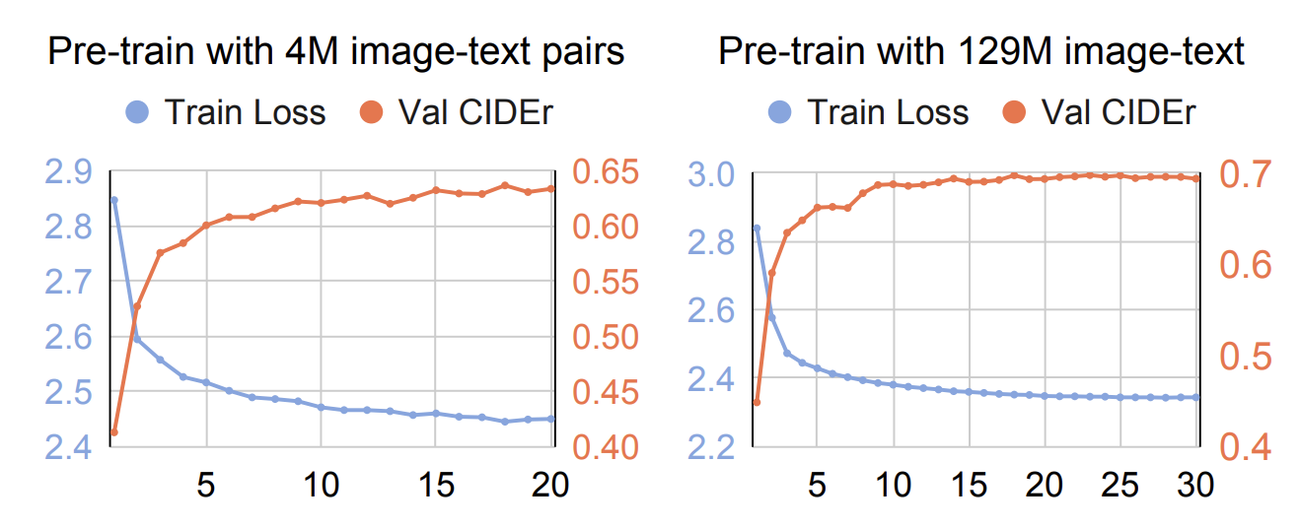
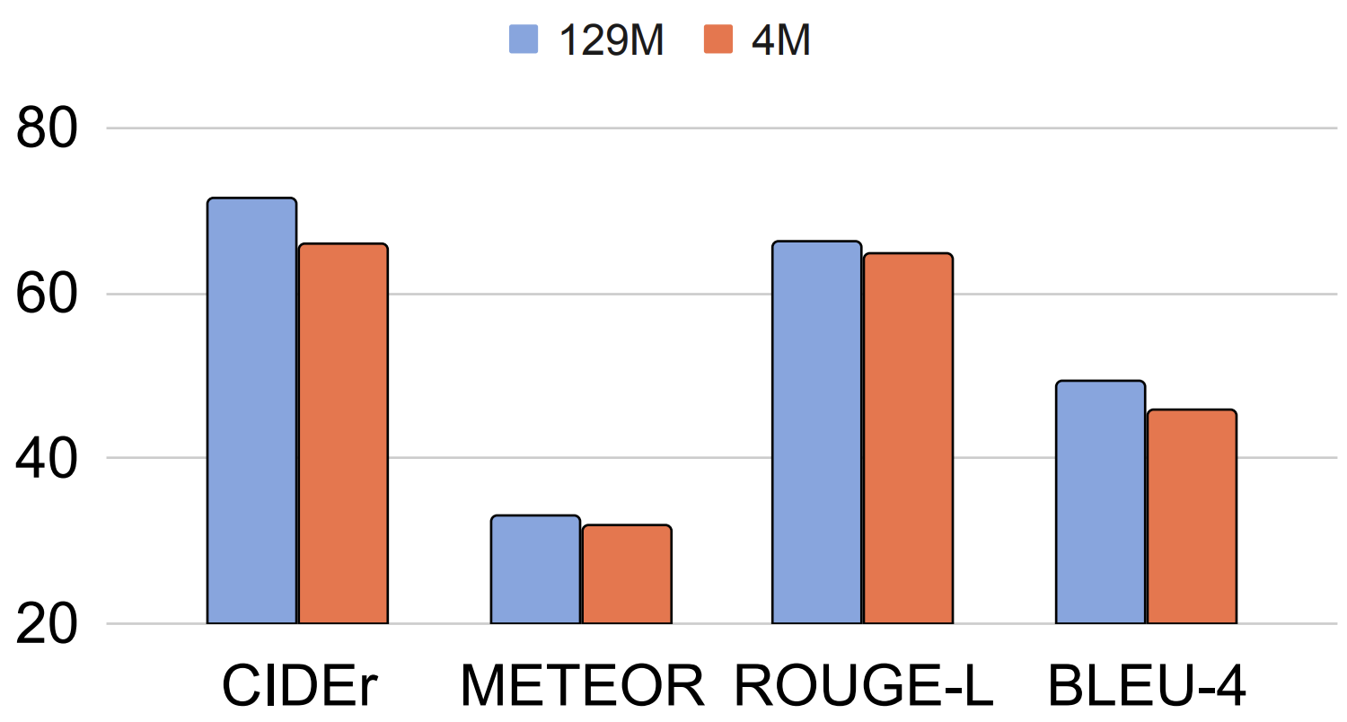
Key Findings
Data Efficiency:
Larger image-text pretraining datasets improve performance

Slide 17
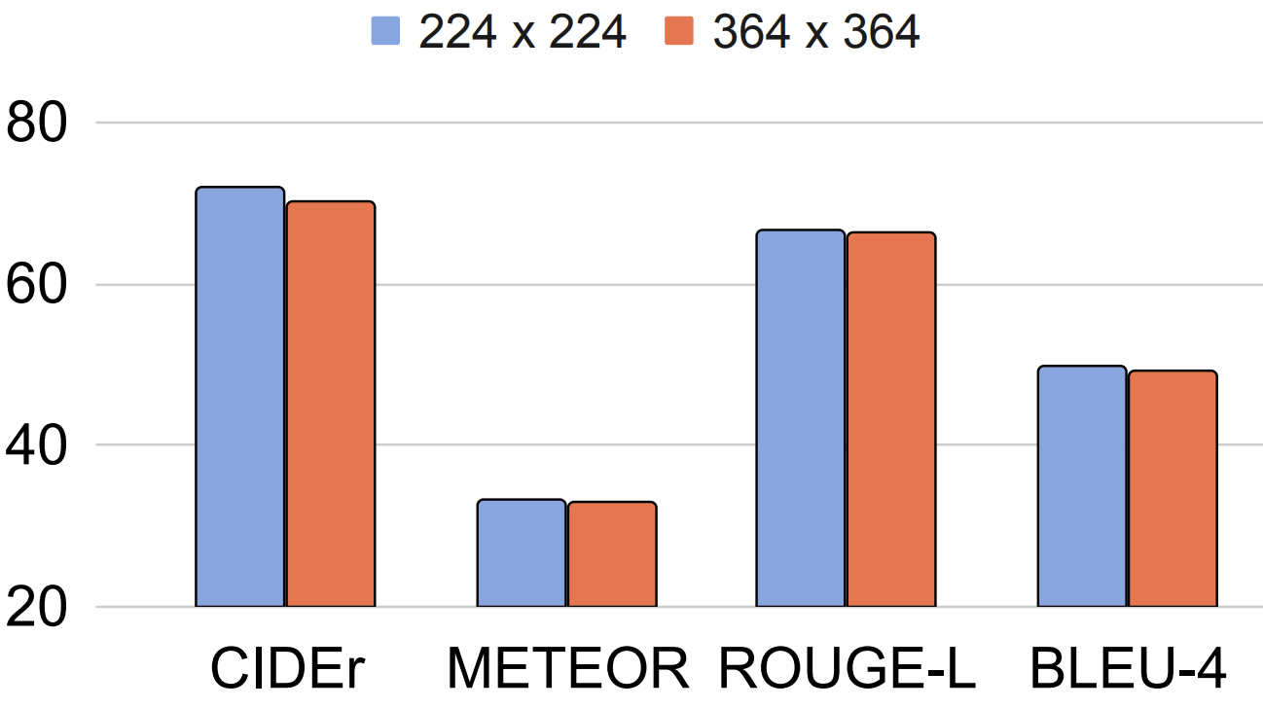
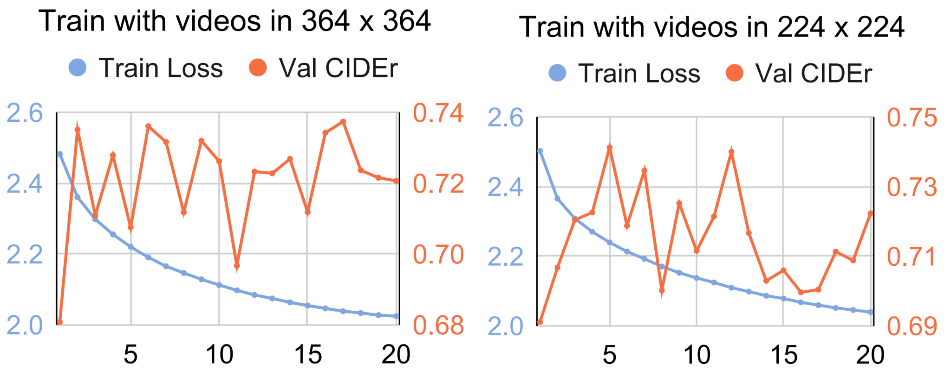
Key Findings
Data Efficiency:
Lower resolution (224x224) works efficiently

Slide 18
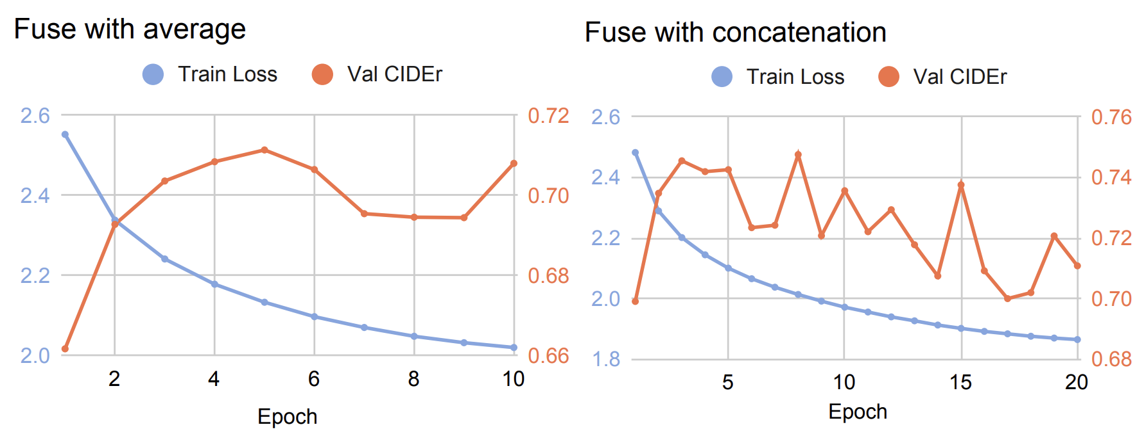
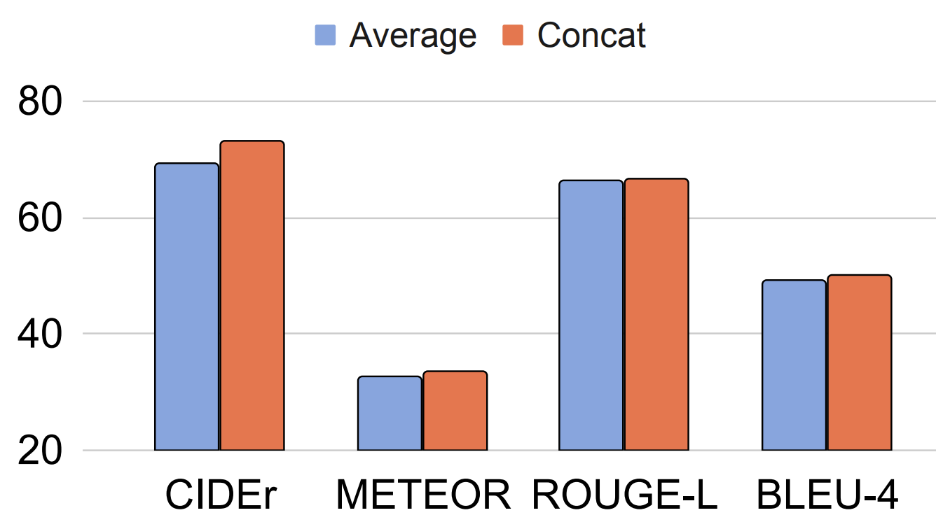
Key Findings
Data Efficiency:
Frame concatenation better captures temporality than averaging

Slide 19
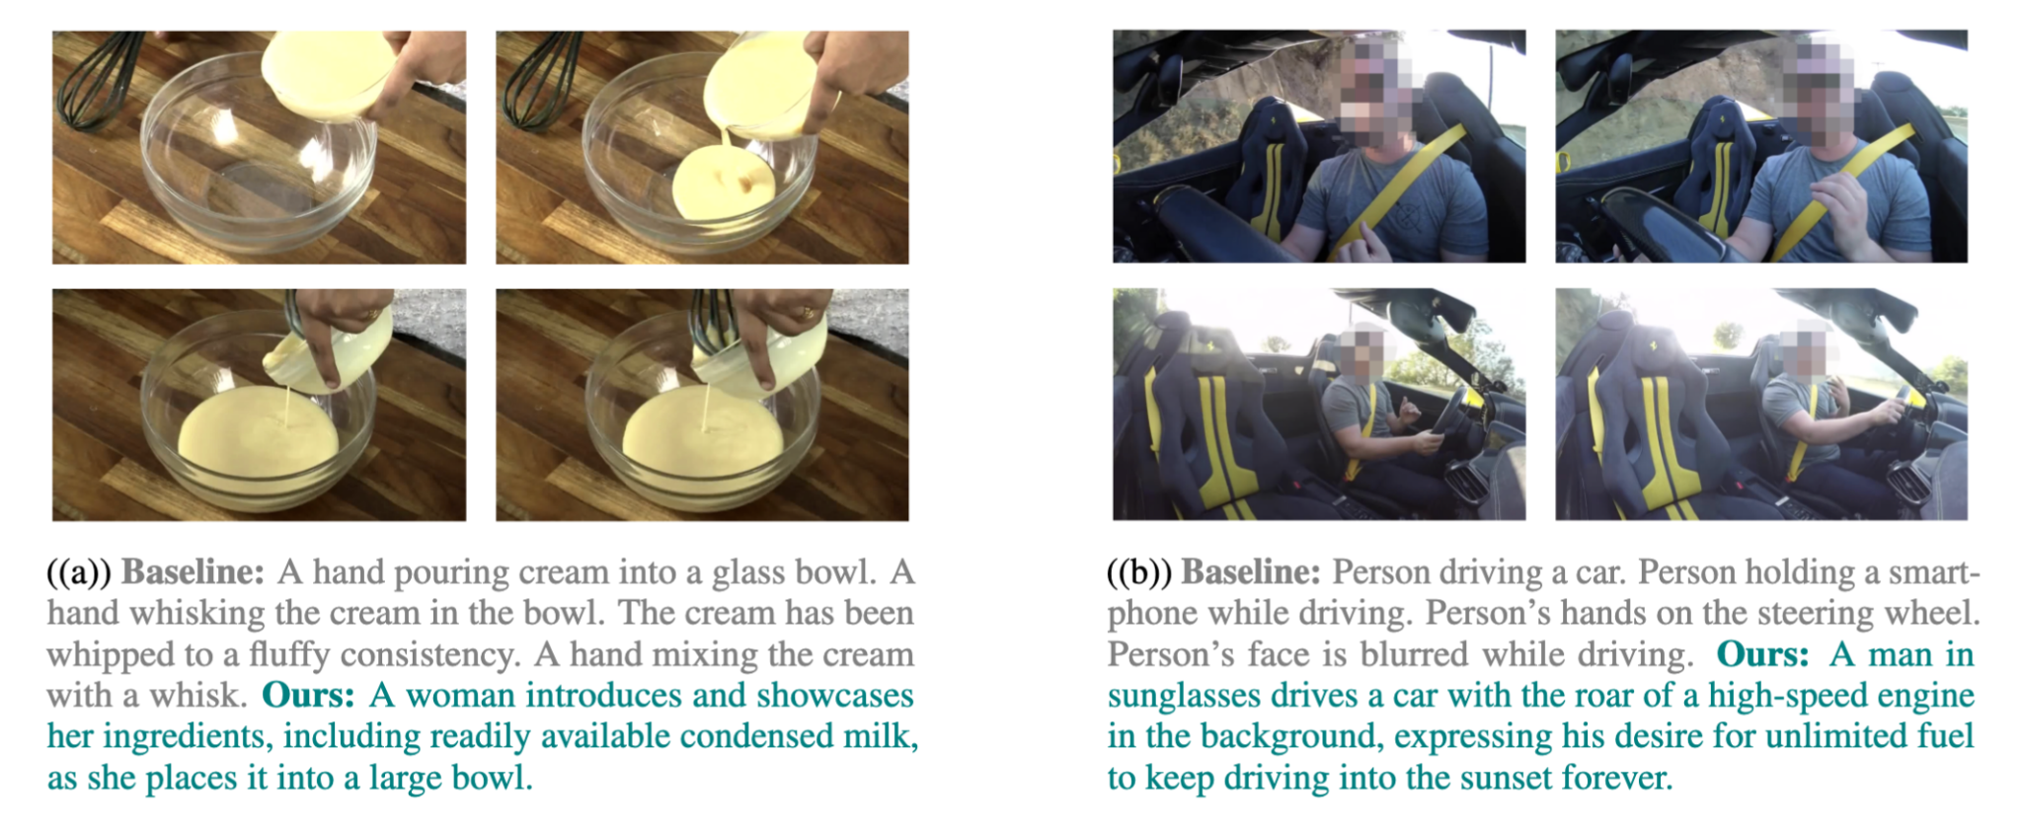
Qualitative Comparison: InstructBLIP v.s. Ours
Notes:
The qualitative comparison highlights significant differences between the captions generated by InstructBLIP and our model. InstructBLIP, which lacks training on extensive video captioning datasets, struggles to capture the visual dynamics and temporal coherence across different frames. Its captions are often static, describing isolated frames without integrating temporal changes or interactions. In contrast, our model demonstrates a nuanced understanding of visual dynamics across temporal frames, effectively integrating information to produce contextually rich and temporally coherent descriptions. This improvement can be attributed to the visual captioning training incorporated in our model, enabling it to better interpret and narrate dynamic visual content.

Slide 20
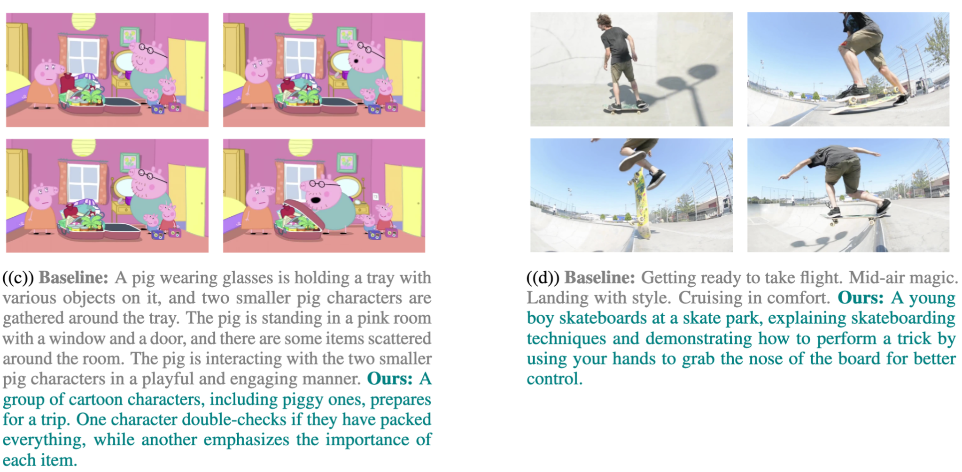
Qualitative Comparison: InstructBLIP v.s. Ours
Notes:
The qualitative comparison highlights significant differences between the captions generated by InstructBLIP and our model. InstructBLIP, which lacks training on extensive video captioning datasets, struggles to capture the visual dynamics and temporal coherence across different frames. Its captions are often static, describing isolated frames without integrating temporal changes or interactions. In contrast, our model demonstrates a nuanced understanding of visual dynamics across temporal frames, effectively integrating information to produce contextually rich and temporally coherent descriptions. This improvement can be attributed to the visual captioning training incorporated in our model, enabling it to better interpret and narrate dynamic visual content.

Slide 21
Summary
Identified shortcut in current InstructBLIP’s visual understanding
Key factors for recycling instructBLIP to video captioning
Achieved top performance with minimal resources by RL

